Slide 1

REFLOW
Workshop
2019
Vu Phuong Hoang

Slide 2
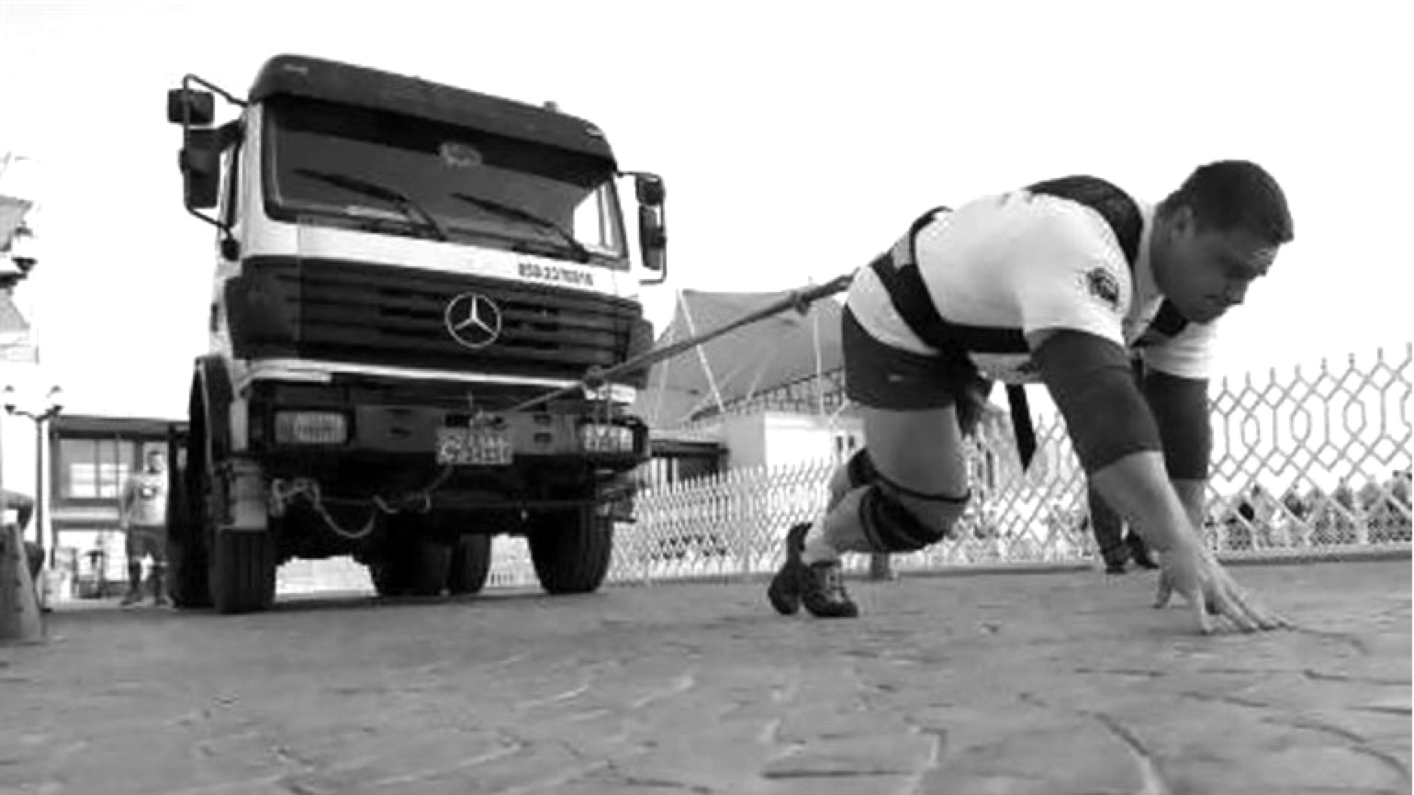
Main content
How is a web page rendered ?
My animation is lag. Why ?
Similar animation is smooth. How ?
Check this out for some experiments
Frame Rate
A “simple” loop

Slide 3
“ Code first, think later !”
- Your fingers -

Slide 4
TOOLS
Google Chrome (version 73)
Sublime Text 3 or any text editor with syntax highlighting
Git or Fork / SourceTree

Slide 5
PART 1
index.html
Animate as many balls as possible @ 60 FPS

Slide 6
Version 0
Branch: feature/animate-position/v0
Key technique: Update ball positions by ‘setInterval’
function update_v0 (timestamp) {
for (var m = 0; m < MOVERS_COUNT; m++) {
movers[m].style.left = topToLeft(movers[m].offsetTop, timestamp) + 'px';
}
}

Slide 7
Chrome Devtools

Slide 8
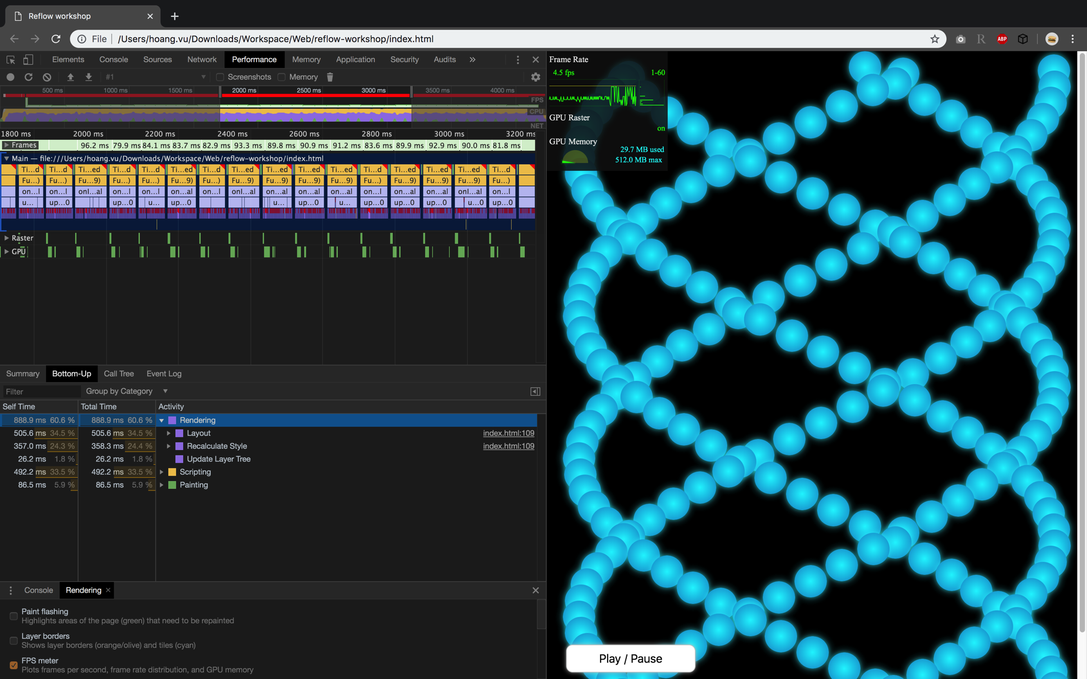
v0 – 200 balls
Unstable frame rate
“Rendering” takes too much time

Slide 9
Version 0
Branch: feature/animate-position/v0
Key technique: Update ball positions by ‘setInterval’
Problems:
Unstable frame rate
Rendering activities (Recalculate style, Layout) take too much time
Can’t reach 60FPS with just 100-200 balls

Slide 10
Unstable frame rate ?
same interval
Others
interval
Others
interval
Others
Reality
Uneven frame time
Others
remain
interval
Others
Others
remain
interval
Expectations
even frame time

Slide 11
requestAnimationFrame

Slide 12
Version 1
Branch: feature/animate-position/v1
Key technique: Update ball positions by ‘requestAnimationFrame’
function update_v1 (timestamp) {
for (var m = 0; m < MOVERS_COUNT; m++) {
movers[m].style.left = topToLeft(movers[m].offsetTop, timestamp) + 'px';
}
//if (window.running) setTimeout( onInterval, 1000.0 / 60 );
if (window.running) rAF( updateFunc );
}
Replace ‘setInterval’
by ‘setTimeout’
in v.0b

Slide 13
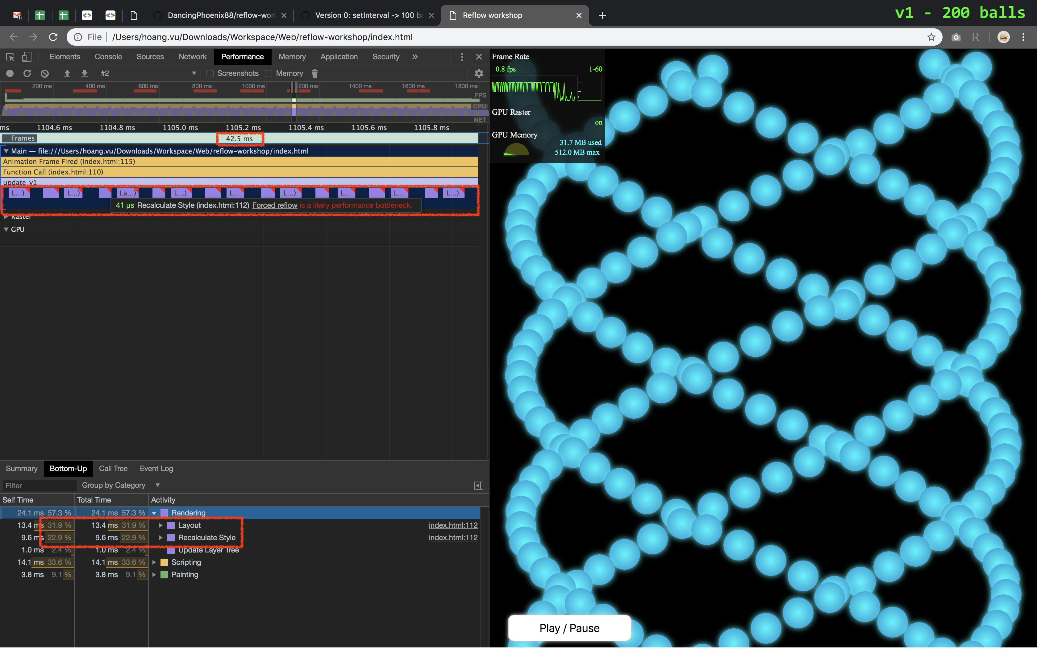
Forced reflow ???
“Rendering” takes too much time

Slide 14
Version 1
Branch: feature/animate-position/v1
Key technique: Update ball positions by ‘requestAnimationFrame’
Problems:
Unstable frame rate
Rendering activities (Recalculate style, Layout) take too much time
Can’t reach 60FPS with just 100-200 balls

Slide 15
“ Code first, think later !”
- Your fingers -
DON’T

Slide 16
Web Rendering Pipeline
Javascript
Style
Layout
Paint
Composite
Javascript: Execute JS code to interact with DOM tree
Style: Calculate style in CSSOM tree to apply to DOM tree
Layout: Calculate position & size to arrange elements in the web page
Paint: Draw elements into layers
Composite: Apply final transformations to layers and draw to screen

Slide 17
Web Rendering Pipeline
Javascript
Style
Layout
Paint
Composite
Set style
First frame: Full pipeline to render
Next frames: Depends on Javascript

Slide 18
Recomposite
Javascript
Style
Layout
Paint
Composite
Set style
Only ‘opacity’ / ‘transform’ ?
If only ’opacity’ & ‘transform’ were changed → re-composite only (BEST)

Slide 19
Repaint
Javascript
Style
Layout
Paint
Composite
Set style
‘color’
If “paint” attributes (color, background-image, shadow ...) were changed → re-paint
Re-paint can be heavy if too many changes
Re-paint is slow on mobile devices

Slide 20
Reflow / Relayout
Javascript
Style
Layout
Paint
Composite
Set style
If “layout” attributes (margin, width, ...) were changed → re-layout (full pipeline)
Reflow leads to repaint & recomposite → Slow
But browser will wait to perform reflow in batch → Great

Slide 21
Restyle
Javascript
Style
Layout
Paint
Composite
Get/Set style
When you update style → style needs to be re-calculated
When you get style → style MIGHT need to be re-calculated due to reflow

Slide 22
Forced reflow / Layout thrashing
Javascript
Style
Layout
Paint
Composite
Get style
Re-calculate
style
Sometimes you force browser to reflow to get the latest attributes
This is called “Forced reflow” → Very very bad
Example: e0 changes layout, e1 get ‘offsetTop’

Slide 23
Version 1
Branch: feature/animate-position/v1
Key technique: Update ball positions by ‘requestAnimationFrame’
function update_v1 (timestamp) {
for (var m = 0; m < MOVERS_COUNT; m++) {
movers[m].style.left = topToLeft(movers[m].offsetTop, timestamp) + 'px';
}
if (window.running) rAF( updateFunc );
}
Get layout attribute
Set layout attribute
FORCED REFLOWS !!!

Slide 24
Style
Style
Layout
Layout
Style
Layout

Slide 25
Version 2
Branch: feature/animate-position/v2
Key technique: Separate getting & setting style
Get layout attribute
function update_v2 (timestamp) {
for (var m = 0; m < MOVERS_COUNT; m++) {
lefts[m] = topToLeft(movers[m].offsetTop, timestamp);
}
for (var m = 0; m < MOVERS_COUNT; m++) {
movers[m].style.left = lefts[m] + 'px';
}
if (window.running) rAF( updateFunc );
}
Set layout attribute

Slide 26
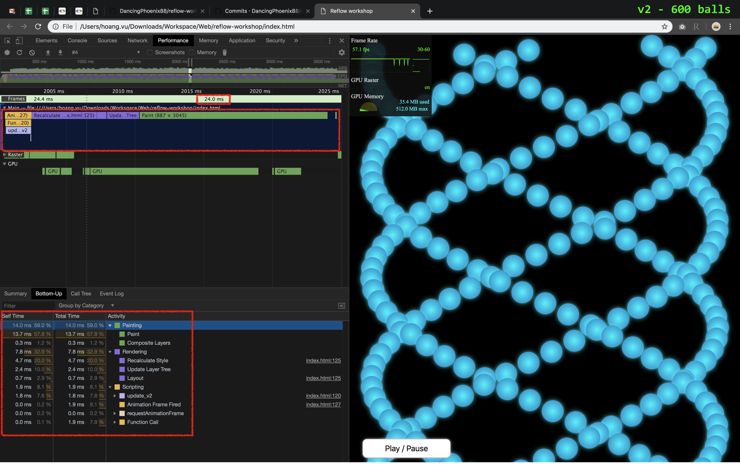
No forced reflows !

Slide 27
Version 2
Branch: feature/animate-position/v2
Key technique: Separate getting & setting style
Good:
No forced reflows
Animate 600 balls @ 60FPS

Slide 28

600 balls

Slide 29
but wait ...

Slide 30
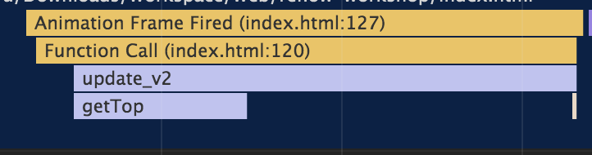
Version 2
Branch: feature/animate-position/v2
Key technique: Separate getting & setting style
Just getting ‘offsetTop’ takes 20-30% time. And they are FIXED numbers !!!
function getTop(m) { return movers[m].offsetTop; }

Slide 31
Version 3
Branch: feature/animate-position/v3
Key technique: Cache frequently-used values
Store ‘offsetTop’ in ‘tops’ array
function update_v3 (timestamp) {
for (var m = 0; m < MOVERS_COUNT; m++) {
movers[m].style.left = topToLeft(tops[m], timestamp) + 'px';
}
if (window.running) rAF( updateFunc );
}

Slide 32
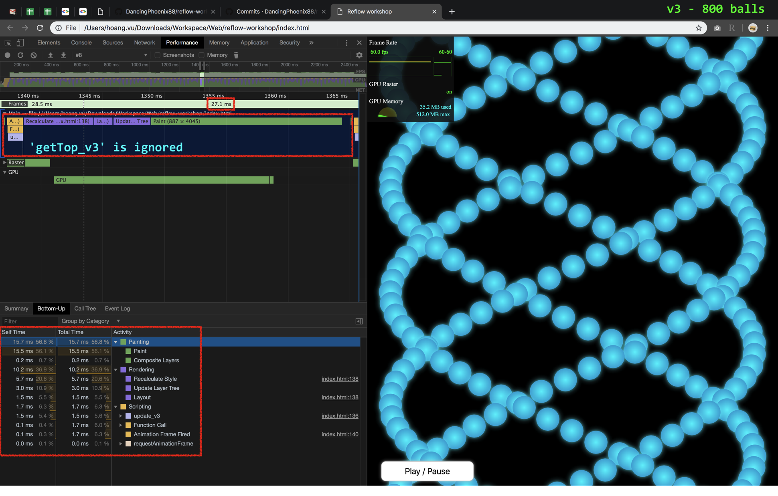
updateFunc is fast

Slide 33
800 balls

Slide 34
Version 3
Branch: feature/animate-position/v3
Key technique: Cache frequently-used values
Good: Can handle 800 balls
Bad:
Rendering (calculating style & layout) takes too much time (10.2ms)
Painting takes too much time (15.7ms)
*Budget: 16.7ms in total to get 60 FPS

Slide 35
top & left cause reflow,
transform doesn’t

Slide 36
Version 4
Branch: feature/animate-position/v4
Key technique: Replace (‘top’ & ‘left’) by ‘transform(translate)’
function update_v4 (timestamp) {
for (var m = 0; m < MOVERS_COUNT; m++) {
movers[m].style.transform = `translate(${topToLeft(tops[m], timestamp)}px, ${tops[m]}px)`;
}
if (window.running) rAF( updateFunc );
}

Slide 37
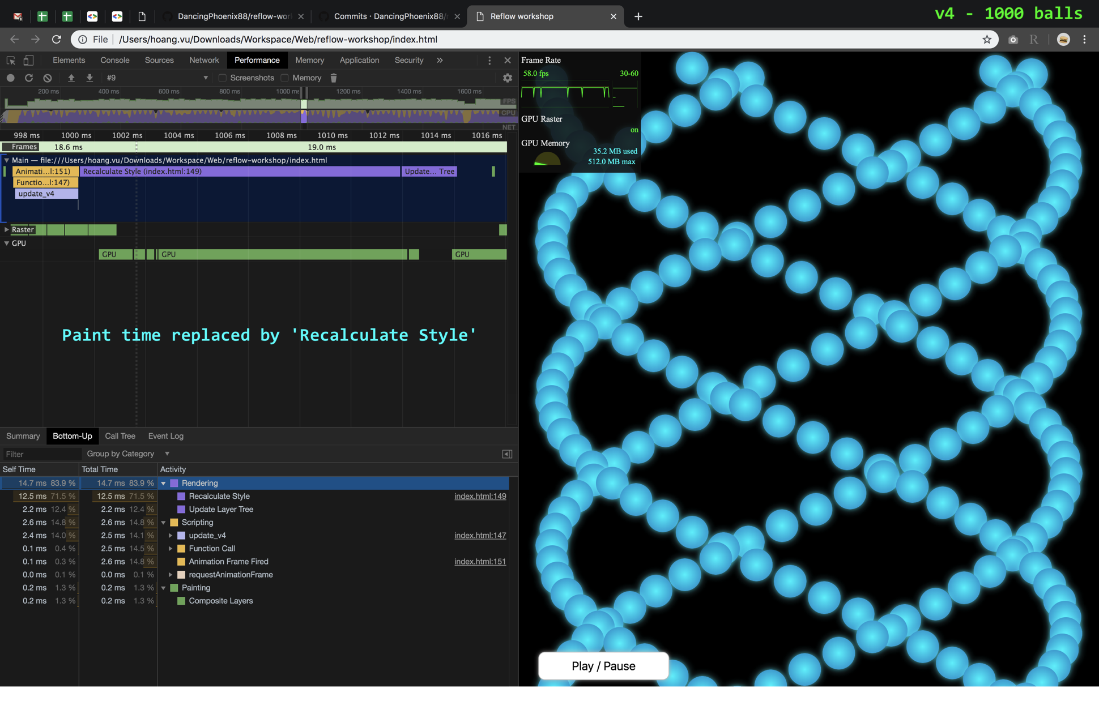

Slide 38
1,000 balls

Slide 39
Version 4
Branch: feature/animate-position/v4
Key technique: Replace (‘top’ & ‘left’) by ‘transform(translate)’
Good:
Can handle 1000 balls (not so much improved)
No re-paint
Bad: Recalculating style still takes too much time

Slide 40
Version 3
Version 4
Re-calculate ‘left’ only
Restyle & Reflow takes 33% time
Re-paint takes 60% time
800 balls
Calculate ‘x’ & ‘y’ in ‘translate’
Restyle & Reflow takes 84% time
No re-paint
1000 balls
No idea to reduce yet
But no-repaint is attractive
I can deal with this
(version 5)

Slide 41
Where are 1,000 balls ?
Oh, they’re not in viewport

Slide 42
Why draw balls
we can’t see ???

Slide 43
Version 5
Branch: feature/animate-position/v5
Key technique: Frustum Culling (hide elements not in viewport / camera)

Slide 44
Version 5
Try to update style
when DOM node is invisible
function update_v5 (timestamp) {
var scrollY = window.scrollY;
for (var m = 0; m < MOVERS_COUNT; m++) {
if (isInViewport(tops[m], scrollY)) {
movers[m].style.left = topToLeft(tops[m], timestamp) + 'px';
movers[m].style.display = 'block’;
} else if (m != MOVERS_COUNT - 1) { // never hide the last mover to keep page size
movers[m].style.display = 'none';
}
}
if (window.running) rAF( updateFunc );
}

Slide 45
Guess the number

Slide 46
12,000 balls

Slide 47
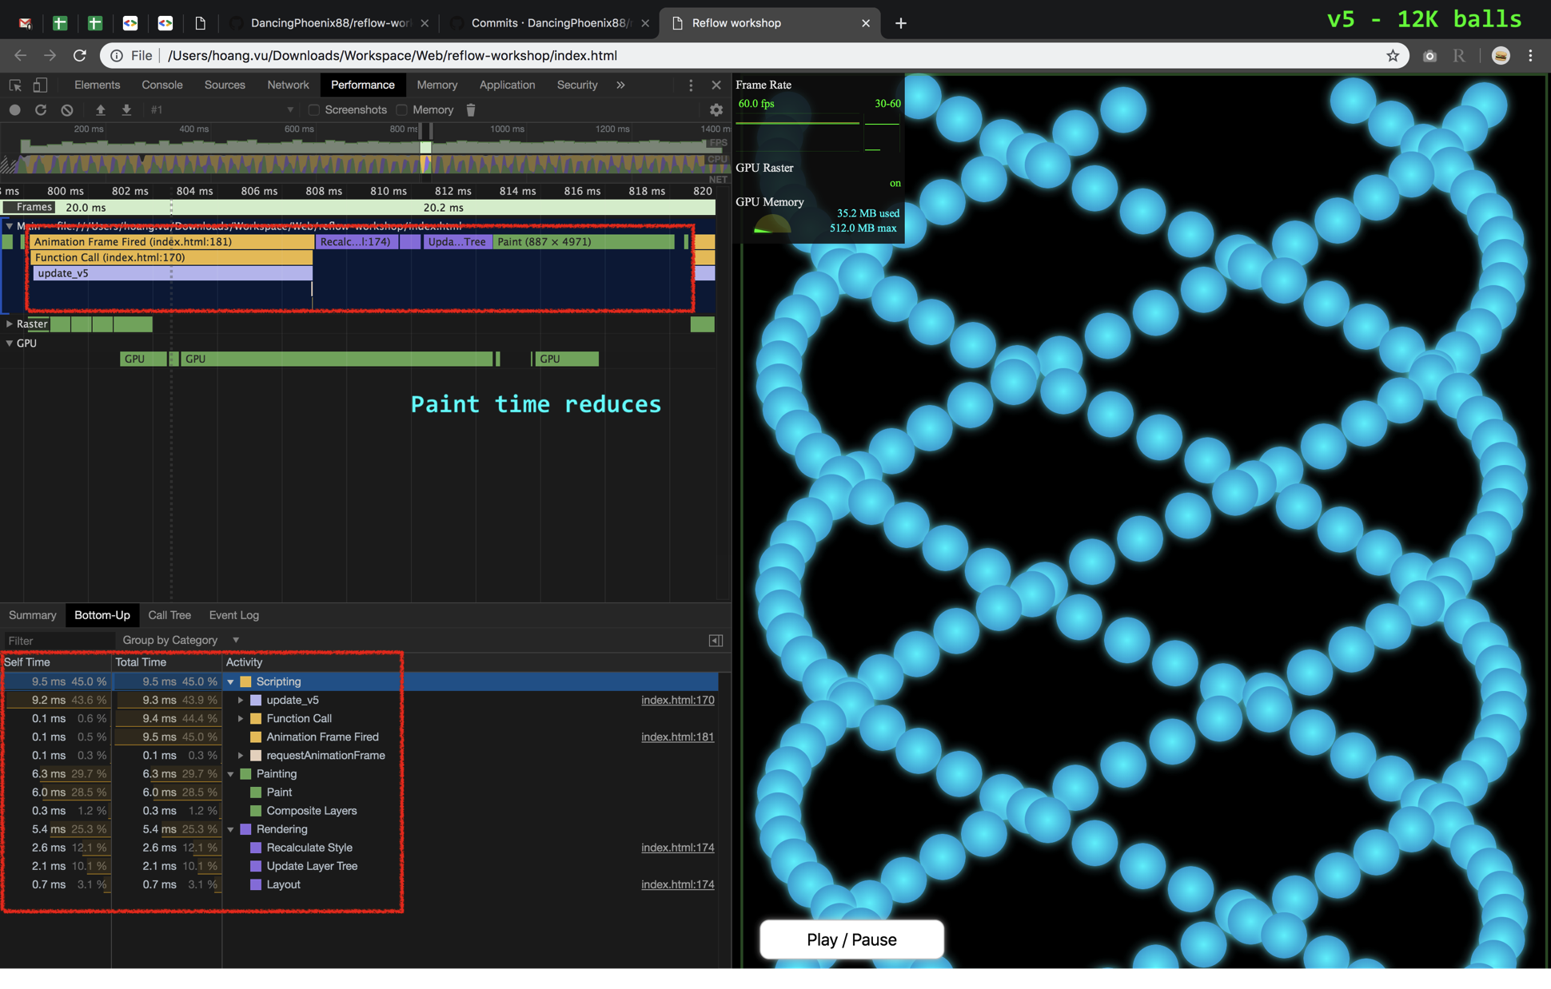

Slide 48
Chrome Devtools
Tab ‘Layer’

Slide 49
Version 5
Branch: feature/animate-position/v5
Key technique: Frustum Culling (hide elements not in viewport / camera)
Good:
Can handle 12K balls
Painting time is mostly fixed no matter how many balls we have
Bad: ’display:none’ causes reflow

Slide 50
Version 6
Branch: feature/animate-position/v6
Key technique: Hiding elements by moving between parent nodes

Slide 51
Version 6
function update_v6 (timestamp) {
var scrollY = window.scrollY;
for (var m = 0; m < MOVERS_COUNT; m++) {
if (isInViewport(tops[m], scrollY)) {
movers[m].style.left = topToLeft(tops[m], timestamp) + 'px';
if (isHidden(m)) showImmediately(m);
} else if (m != MOVERS_COUNT - 1) { // never hide the last mover to keep page size
if (isVisible(m)) hide(m);
}
}
if (window.running) rAF( updateFunc );
}

Slide 52
Guess the number

Slide 53
80,000 balls

Slide 54
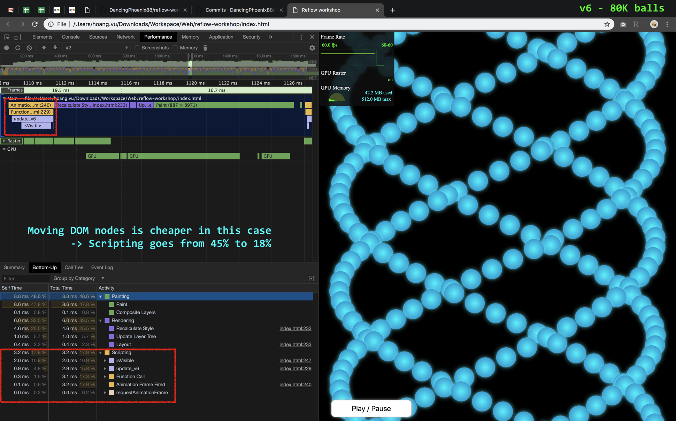

Slide 55
Version 6
Branch: feature/animate-position/v6
Key technique: Hiding elements by moving between parent nodes
Good:
Can handle 12K balls
Painting time is mostly fixed no matter how many balls we have
Bad: ’isInViewport’ is slow

Slide 56
Version 6
function update_v6 (timestamp) {
var scrollY = window.scrollY;
for (var m = 0; m < MOVERS_COUNT; m++) {
if (isInViewport(tops[m], scrollY)) {
movers[m].style.left = topToLeft(tops[m], timestamp) + 'px';
if (isHidden(m)) showImmediately(m);
} else if (m != MOVERS_COUNT - 1) { // never hide the last mover to keep page size
if (isVisible(m)) hide(m);
}
}
if (window.running) rAF( updateFunc );
}
Check every balls

Slide 57
Version 7
Branch: feature/animate-position/v7
Key technique: Pre-calculate visible index
function update_v7 (timestamp) {
var scrollY = window.scrollY;
var minVisibleM = Math.floor(getMinVisibleY(scrollY) / OFFSET);
var maxVisibleM = Math.ceil(getMaxVisibleY(scrollY) / OFFSET);
batchHide( 0, minVisibleM - 1 );
batchHide( maxVisibleM + 1, MOVERS_COUNT ); // hide ASAP before drawing
batchDraw( minVisibleM, maxVisibleM, timestamp );
if (window.running) rAF( updateFunc );
}

Slide 58
Guess the number

Slide 59
140,000 balls

Slide 60
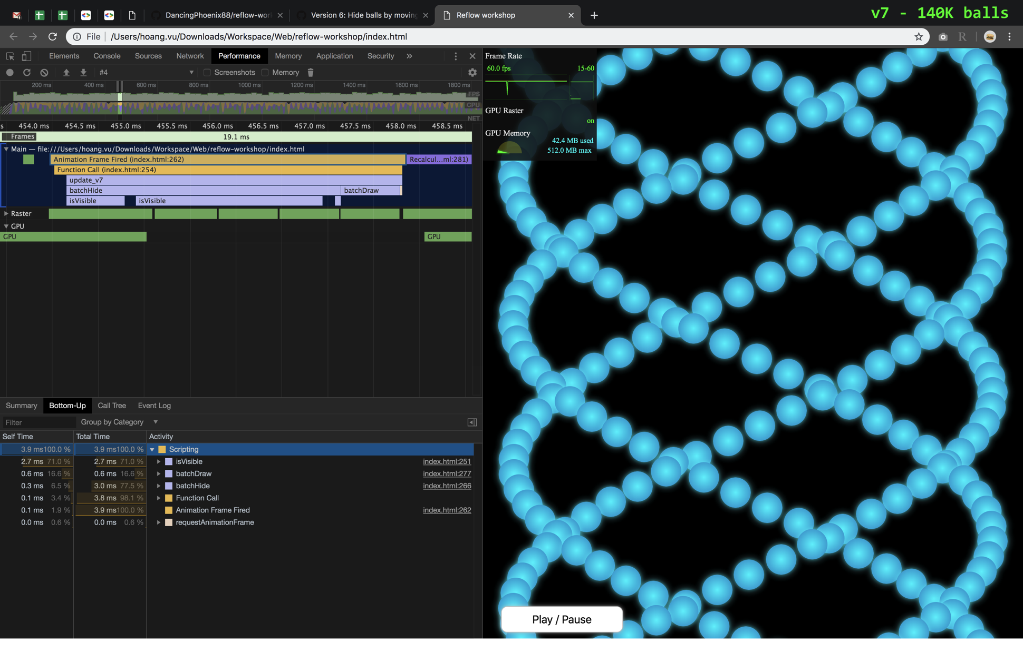
batchHide & isVisible
takes long time

Slide 61
Version 7
Branch: feature/animate-position/v7
Key technique: Pre-calculate visible index
function update_v7 (timestamp) {
var scrollY = window.scrollY;
var minVisibleM = Math.floor(getMinVisibleY(scrollY) / OFFSET);
var maxVisibleM = Math.ceil(getMaxVisibleY(scrollY) / OFFSET);
batchHide( 0, minVisibleM - 1 );
batchHide( maxVisibleM + 1, MOVERS_COUNT ); // hide ASAP before drawing
batchDraw( minVisibleM, maxVisibleM, timestamp );
if (window.running) rAF( updateFunc );
}
Keep hiding
invisible elements

Slide 62
Version 8
Branch: feature/animate-position/v8
Key technique: Only touch changed balls (diff)
function update_v8 (timestamp) {
var scrollY = window.scrollY;
var minVisibleM = Math.floor(getMinVisibleY(scrollY) / OFFSET);
var maxVisibleM = Math.ceil(getMaxVisibleY(scrollY) / OFFSET);
// Compare minVisibleM, maxVisibleM with prevMinM, prevMaxM ... (next slides)
prevMinM = minVisibleM;
prevMaxM = maxVisibleM;
if (window.running) rAF( updateFunc );
}

Slide 63
Version 8 – case 1
prevMinM
prevMaxM
Previous frame
visible
This frame
minVisibleM
maxVisibleM
if (prevMinM == minVisibleM) {
batchMove( minVisibleM, maxVisibleM, timestamp );
}

Slide 64
Version 8 – case 2
prevMinM
prevMaxM
Previous frame
This frame
minVisibleM
maxVisibleM
if (minVisibleM > prevMaxM || maxVisibleM < prevMinM) {
forceHide( prevMinM, prevMaxM );
batchMove( minVisibleM, maxVisibleM, timestamp );
forceShow( minVisibleM, maxVisibleM );
}
No need to check
slow isVisible / isHidden

Slide 65
Version 8 – case 3 (4 is similar)
prevMinM
prevMaxM
Previous frame
This frame
minVisibleM
maxVisibleM
if (minVisibleM > prevMaxM || maxVisibleM < prevMinM) {
forceHide( prevMinM, minVisibleM – 1 );
batchMove( minVisibleM, maxVisibleM, timestamp );
forceShow( prevMaxM + 1, maxVisibleM );
}

Slide 66
Version 8 – First frame
First frame is special
Hide every balls
Move & draw only visible balls
Integrated to case #2

Slide 67
Guess the number

Slide 68
1,000,000 balls
(not max)

Slide 69
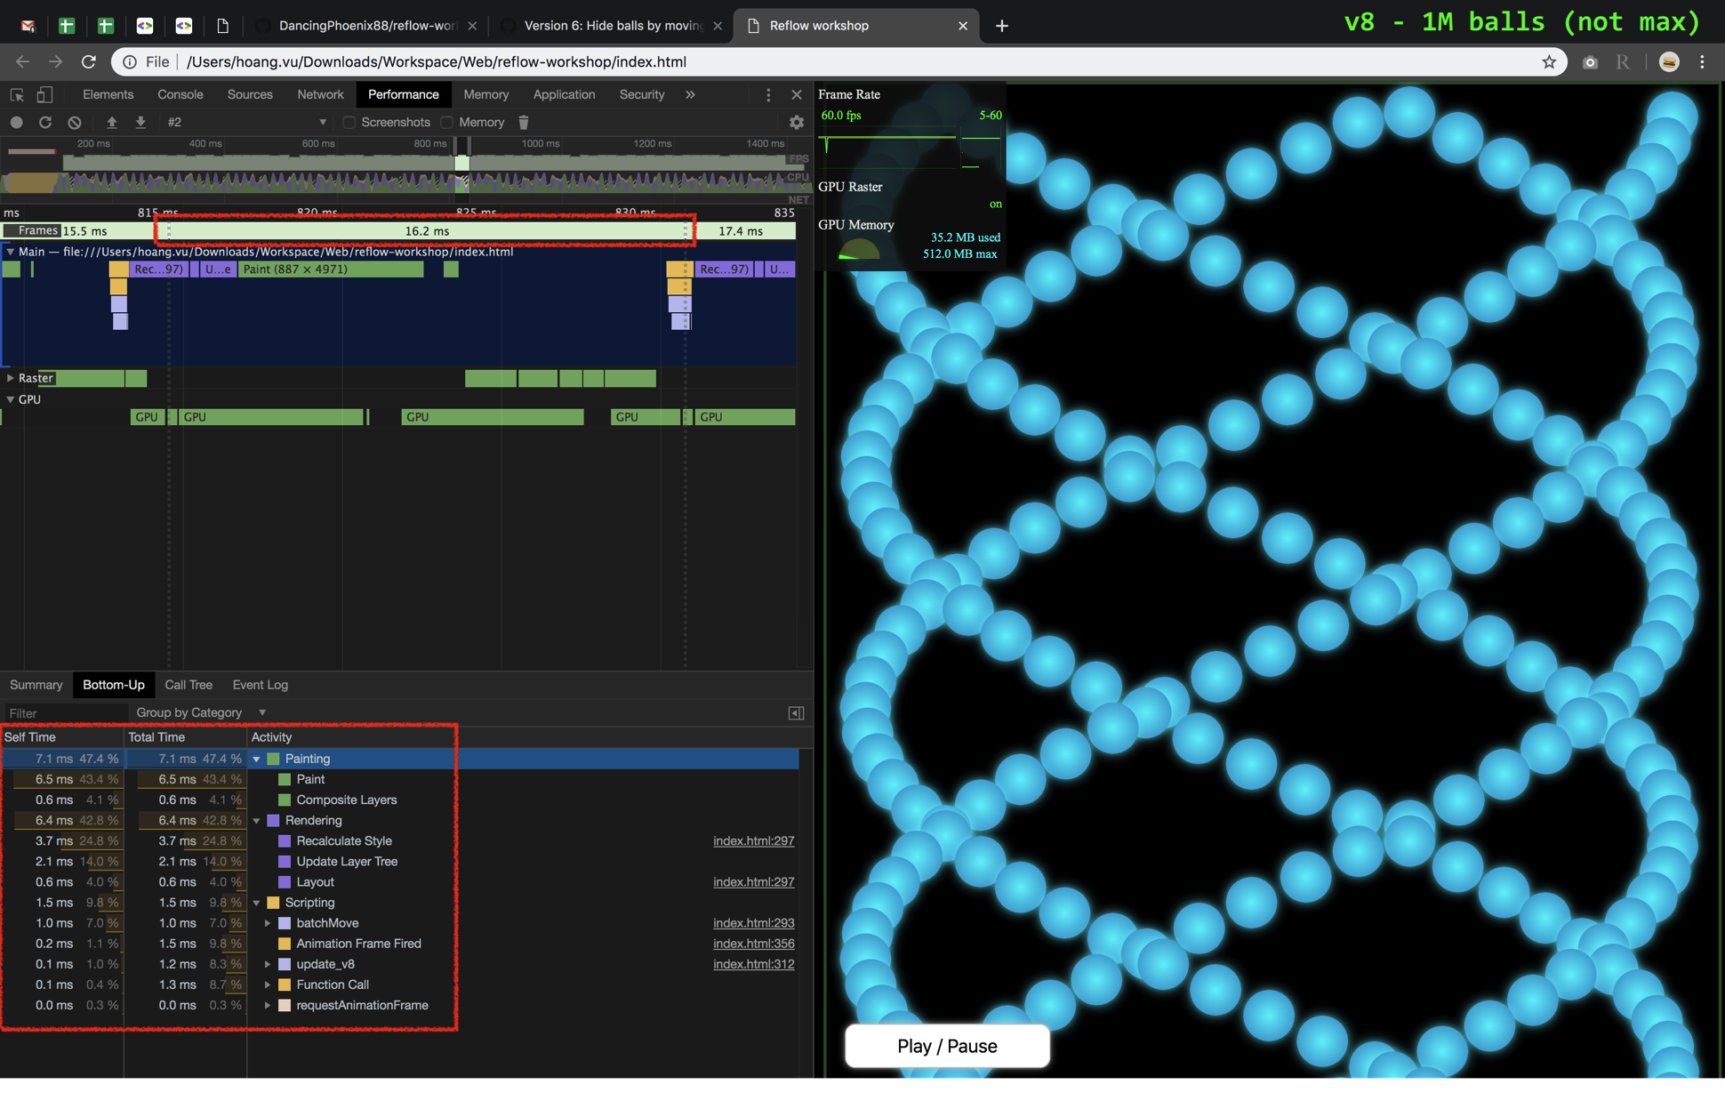

Slide 70
Version 8
Branch: feature/animate-position/v8
Key technique: Only touch changed balls (diff)
Good:
Tested with 1M balls
Worst case: Process 2 x visible balls
→ No need to improve more

Slide 71
Use ‘requestAnimationFrame’
Forced reflow is performance killer
Grouped getting & setting styles help
Culling reduces paint time
Find & remove repeated calculations
Only update changed elements
Batch changes by DocumentFragment
Use cloneNode to generate elements
WORKSHOP
Part 1
Lessons:

Slide 72
WORKSHOP
Part 1
More:
Find & fix memory leaks
Generate hidden balls by default
Find which CSS attribute is heavy

Slide 73
PART 2
index_3d.html
Animate as many balls as possible @ 60 FPS (in a semi-3D space)

Slide 74
Mimic 3D formula
Rear
π/2
sin function
Front
0
0.5
1
Full cycle

Slide 75
Version 8.1
Branch: feature/animate-3d/v8.1
Key technique: Update ‘width’ & ‘height’ over time
function _batchTransform(from, to, timestamp) {
var x, left, scale;
for (var m = from; m <= to; m++) {
x = tops[m] + timestamp / MOVE_DURATION;
left = (Math.sin(x) + 1) * maxLeft + minLeft;
scale = cycleToScale(xToCycle(x));
movers[m].style.left = left + 'px';
movers[m].style.width =
movers[m].style.height = (ELEMENT_SIZE * scale) + 'px';
}
}

Slide 76
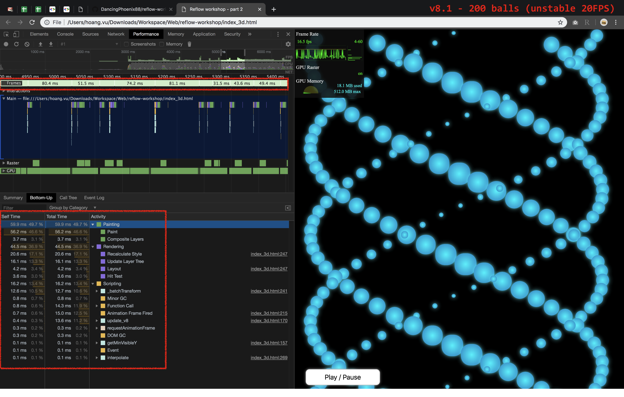

Slide 77
Version 8.1
Branch: feature/animate-3d/v8.1
Key technique: Update ‘width’ & ‘height’ over time
Problems:
Each ball needs to update 3 attributes (I tried ‘cssText’ but still failed)
Many reflows
Frame rate is too low

Slide 78
Version 8.2
Branch: feature/animate-3d/v8.2
Key technique: Animate using ‘transform’
function _batchTransform(from, to, timestamp) {
var x, left, scale;
for (var m = from; m <= to; m++) {
x = tops[m] + timestamp / MOVE_DURATION;
left = (Math.sin(x) + 1) * maxLeft + minLeft;
scale = cycleToScale(xToCycle(x));
movers[m].style.transform = `translate(${left}px, ${tops[m]}px) scale(${scale})`;
}
}

Slide 79
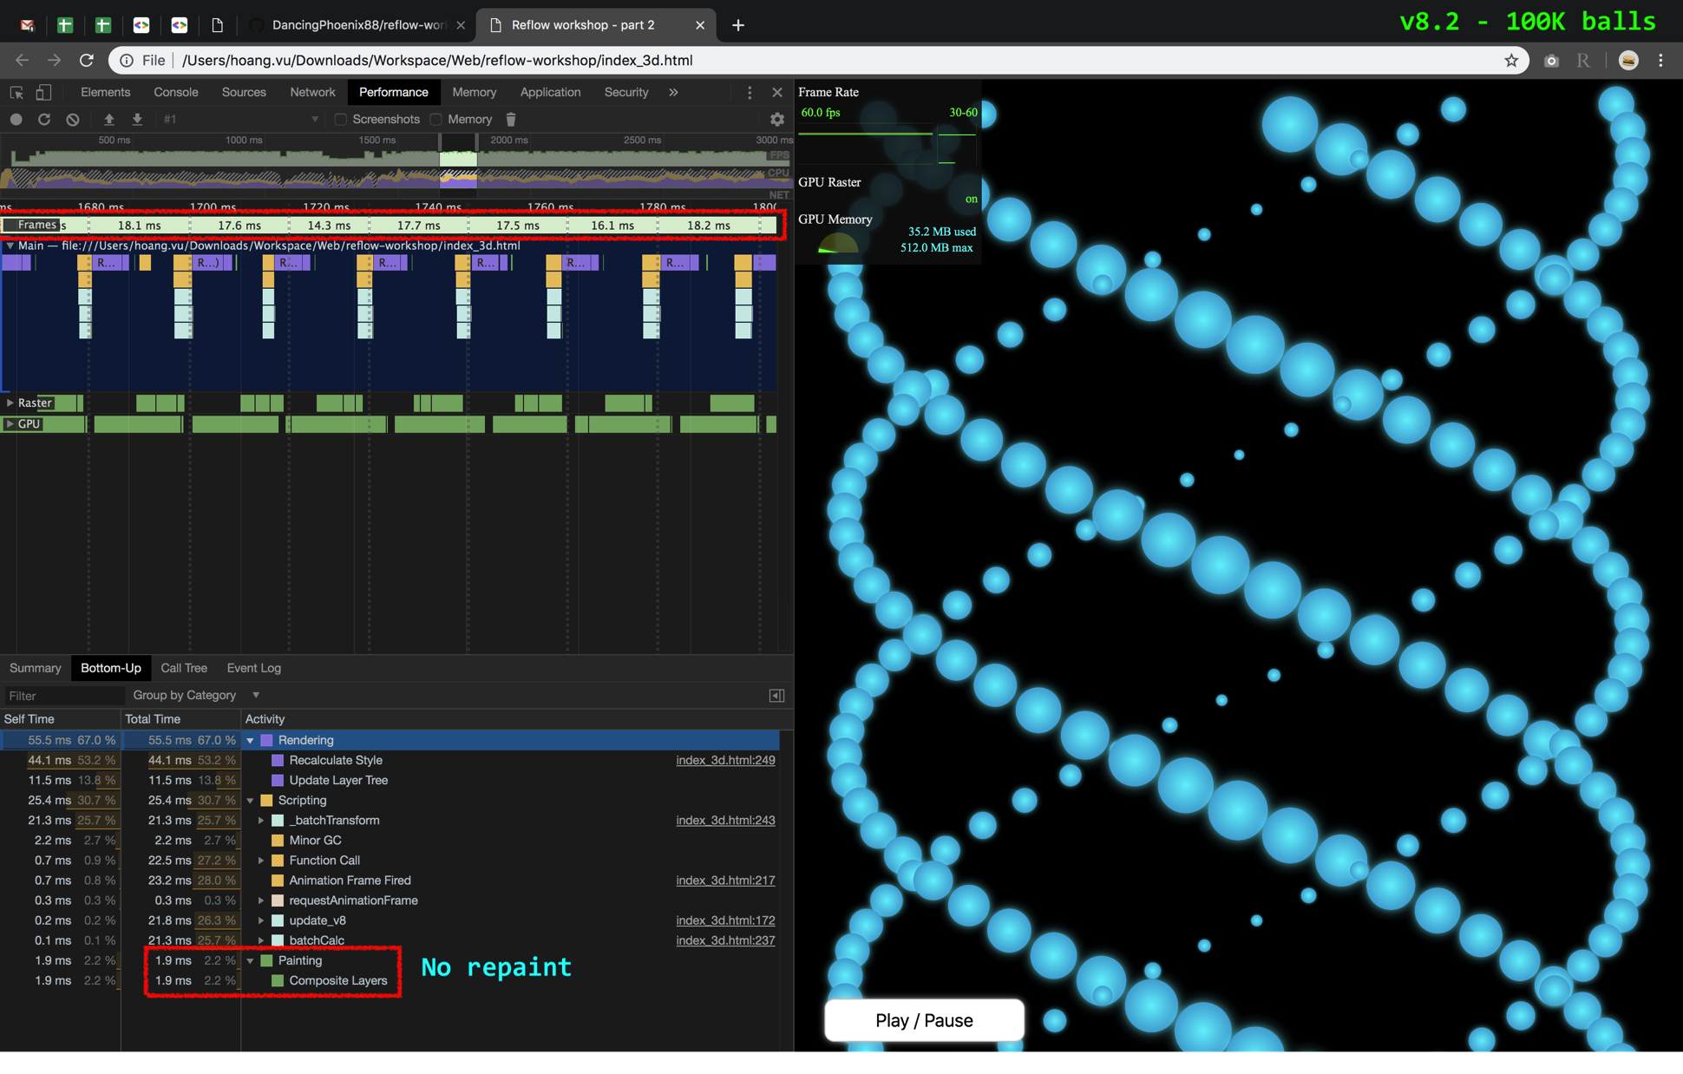

Slide 80
Version 8.2
Branch: feature/animate-3d/v8.2
Key technique: Animate using ‘transform’
Good:
Can handle 100K balls @ 60FPS
No-repaint
But the visual lacks of depth

Slide 81
Version 8.2b
Commit: 1db447982db1dc24733cbf1c36a8db9b4a366d1d
Test: Add ‘opacity:1’ → 100,000 balls @ 60FPS
Test: Add ‘opacity:0.8’ → 200 balls @ 30FPS !!!

Slide 82
If a transparent element updates,
ALL overlapped ones get updating, too

Slide 83
Each opacity element
should be in a separate layer

Slide 84
Version 8.3
Branch: feature/animate-3d/v8.3
Key technique: Add ‘will-change’ attribute
Good:
Can handle 1K balls @ 60FPS
No-repaint
“Depth” added
Visual still lacks lighting elements

Slide 85
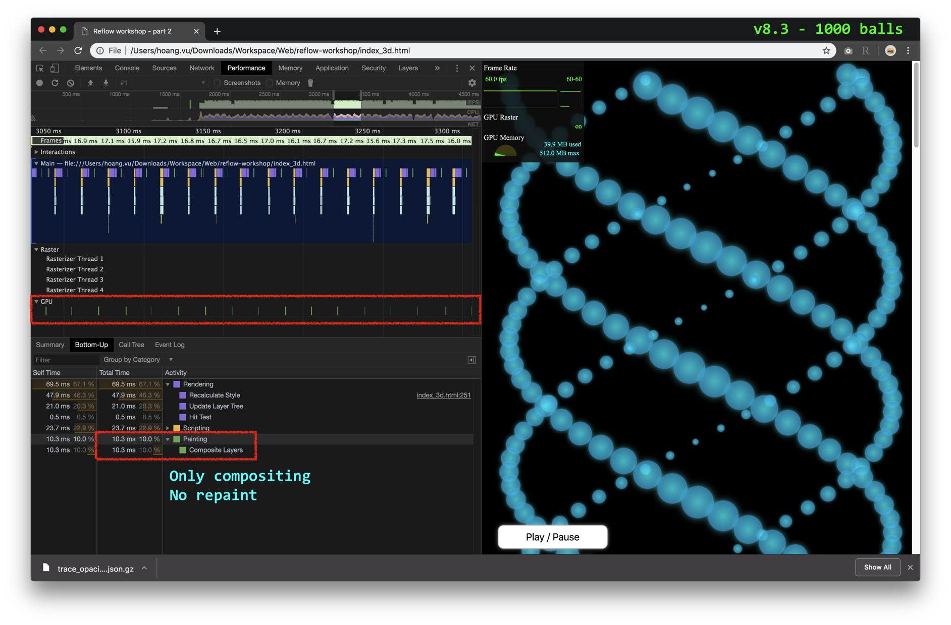

Slide 86
Version 8.4
Branch: feature/animate-3d/v8.4
Key technique: Animate ‘opacity’ attribute
function _batchTransform(from, to, timestamp) {
var x, left, scale, cycle;
for (var m = from; m <= to; m++) {
x = tops[m] + timestamp / MOVE_DURATION;
left = (Math.sin(x) + 1) * maxLeft + minLeft;
cycle = xToCycle(x);
scale = cycleToScale(cycle);
movers[m].style.transform = `translate(${left}px, ${tops[m]}px) scale(${scale})`;
movers[m].style.opacity = cycleToOpacity(cycle);
}
}

Slide 87
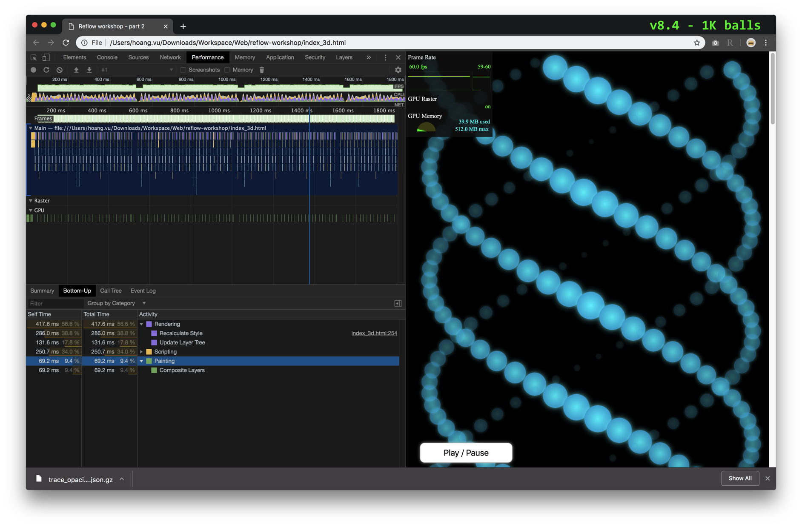

Slide 88
Best CSS attributes for animation:
‘opacity’
‘transform’
‘will-change’ moves element to another layer
WORKSHOP
Part 2
Lessons:

Slide 89
PART 3
index_3d_css.html
Animate as many balls as possible @ 60 FPS (in a semi-3D space) by CSS

Slide 90
Version 9.0
Branch: feature/animate-3d-css/v9.0
Key technique: CSS animation (Test with 1 ball)
@keyframes swing {
0% { opacity: 0.10; transform: translateX( 500px) scale(0.2); animation-timing-function: ease-out; }
25% { opacity: 0.60; transform: translateX(1000px) scale(0.7); animation-timing-function: ease-in; }
50% { opacity: 1.00; transform: translateX( 500px) scale(1.2); animation-timing-function: ease-out; }
75% { opacity: 0.60; transform: translateX( 0px) scale(0.7); animation-timing-function: ease-in; }
100% { opacity: 0.10; transform: translateX( 500px) scale(0.2); animation-timing-function: ease-out; }
}
.mover {
/* ... other attributes are trimmed */
animation-name: swing;
animation-duration: 6.28s; /* 2 * PI * [old]MOVE_DURATION */
animation-iteration-count: infinite;
}

Slide 91
Version 9.1
Branch: feature/animate-3d-css/v9.1
Key technique: Just generate balls (method taken from v6)
Balls can animate by pure CSS, but not so smooth
Modified ‘update_v8’ to show / hide elements only
Problems: All balls start animating at the same time

Slide 92
Version 9.2
Branch: feature/animate-3d-css/v9.2
Key technique: Dynamic delay CSS animations
It looks very closely to JS version
GPU does all the job
var mv = mvPrototype.cloneNode();
var delay = (DELAY * m % ACTUAL_MOVE_DURATION) / 1000;
mv.style.cssText = `top:${m * OFFSET}px; animation-delay:${delay}s`;

Slide 93
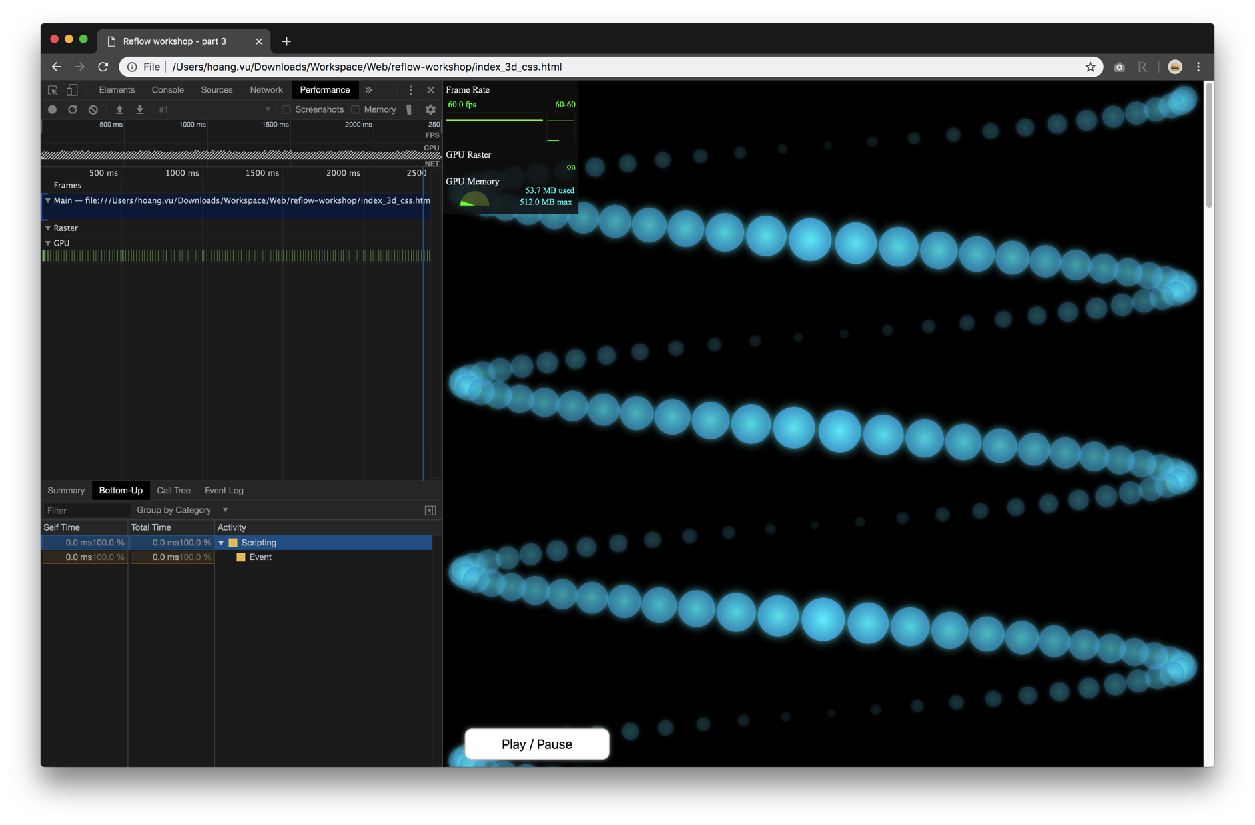

Slide 94
But I can not pause the animations !

Slide 95
Version 9.3
Branch: feature/animate-3d-css/v9.3
Key technique: Change ‘animation-play-state’ automatically
Use CSS selector to control children from parent class
Now button “Play / Pause” works normally
#container.pause .mover {
animation-play-state: paused;
}

Slide 96
How about culling ?

Slide 97
Version 9.4
Branch: feature/animate-3d-css/v9.4
Key technique: Apply culling
Problems: Out-of-sync animations

Slide 98
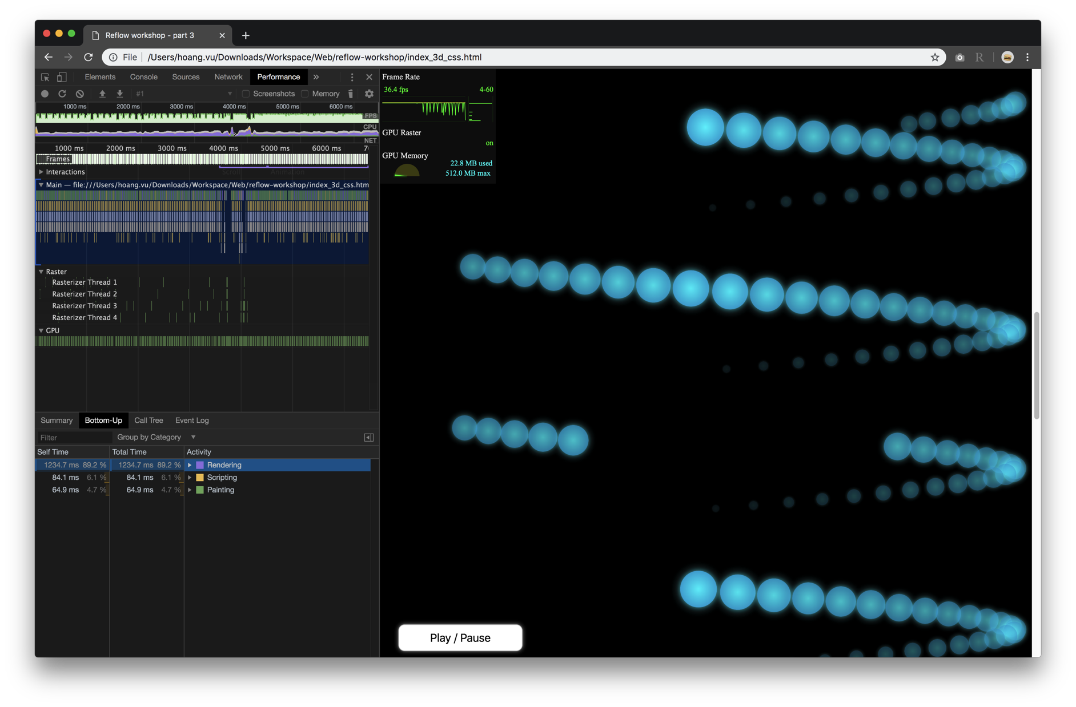

Slide 99
CSS animation is useful for simple case
CSS animation starts immediately
It is hard to control CSS animation
Try CSS custom var in CSS animation
feature/animate-3d-css/v9.5
WORKSHOP
Part 3
Lessons:3

Slide 100
It’s good to understand
how a web page is rendered

Slide 101
What forces reflow ?
JS: https://gist.github.com/paulirish/5d52fb081b3570c81e3a
CSS: https://csstriggers.com/

Slide 102
DOM & Reflow
FastDOM (a library):
Queue ‘get’ & ‘set’ style commands using ‘requestAnimationFrame’ (like v2).
Virtual DOM (a technique):
A snapshot of DOM each frame.
By comparing snapshots, we can send actual changes to real DOM tree (like v8).
Most popular with ReactJS, VueJS
Shadow DOM (a new Web Component):
An isolated DOM sub-tree
Shadow DOM and outter nodes can’t interact with each other
From the outside, Shadow DOM just repaints, like v9

Slide 103
More references
Presentations: https://speakerdeck.com/addyosmani/velocityconf-rendering-performance-case-studies?slide=1
Documents hub:
http://jankfree.org/
https://developers.google.com/web/
http://wilsonpage.co.uk/preventing-layout-thrashing/
https://www.igvita.com/slides/2012/web-performance-for-the-curious/#29
https://www.chromium.org/developers/design-documents/gpu-accelerated-compositing-in-chrome
Advanced profiling tools:
http://dev.chromium.org/developers/how-tos/trace-event-profiling-tool
https://www.html5rocks.com/en/tutorials/games/abouttracing/
https://www.gamasutra.com/view/news/176420/Indepth_Using_Chrometracing_to_view_your_inline_profiling_data.php

Slide 104
Q&A

